Slide 1


HANGOUT
Application to help people socialize

Slide 2
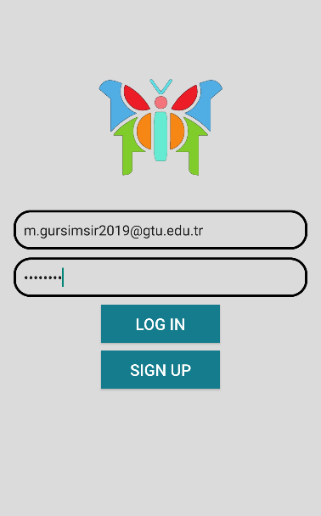
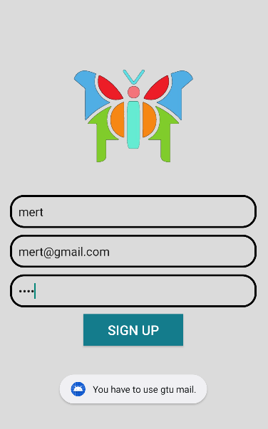

Slide 3
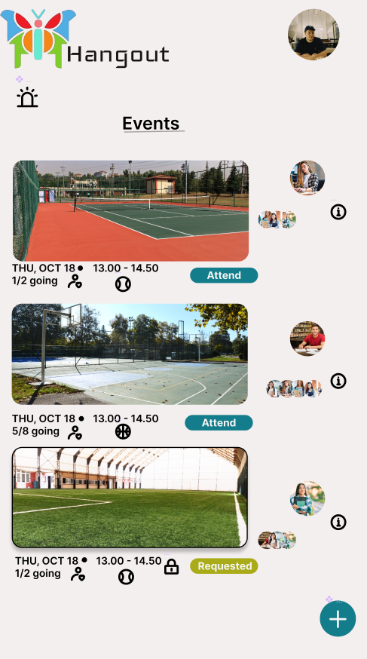
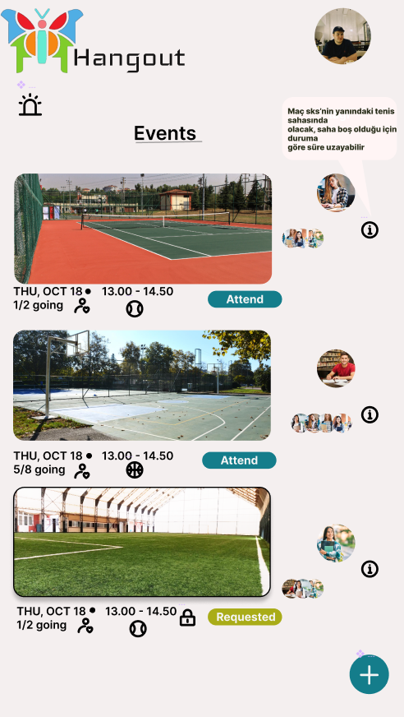

Slide 4
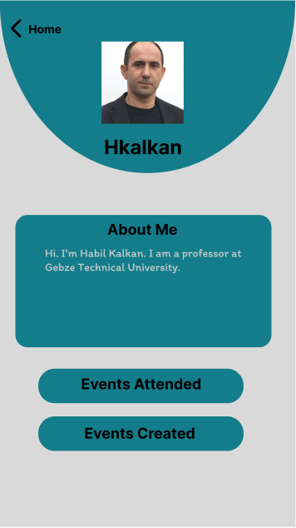
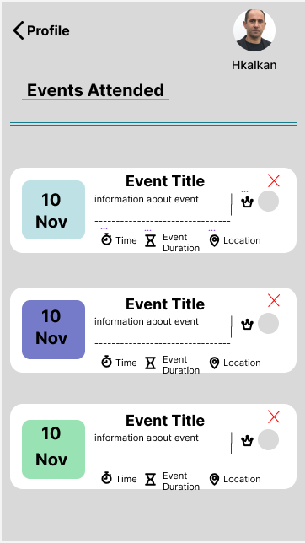
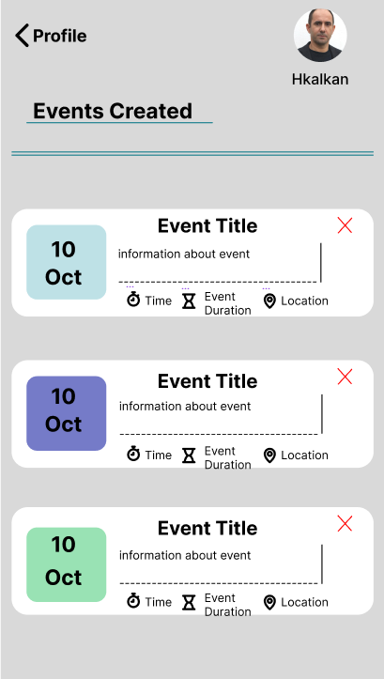

Slide 5
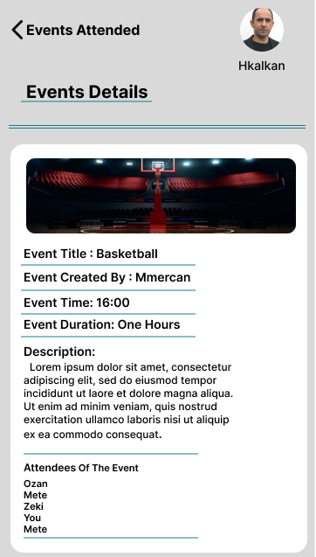
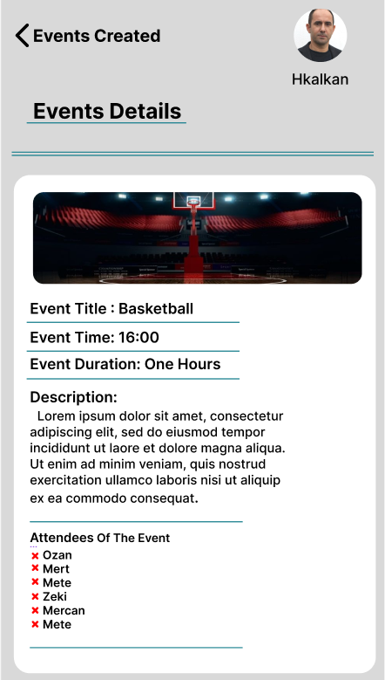

Slide 6
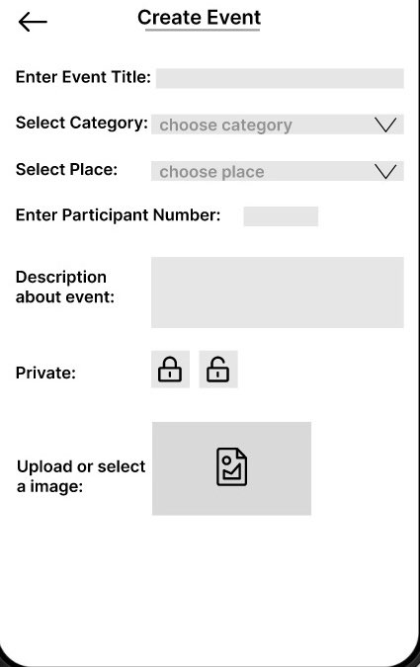
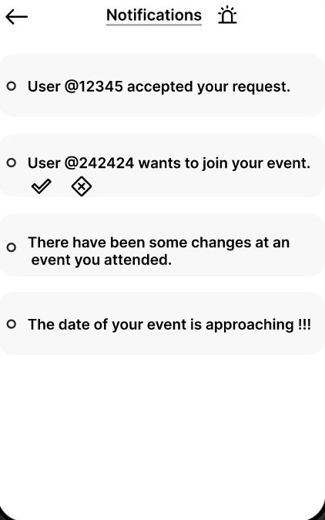

Slide 7
At what stage ıs the project now?
Skeleton of the application
Nerves of the application
Appearance of the application

Slide 8
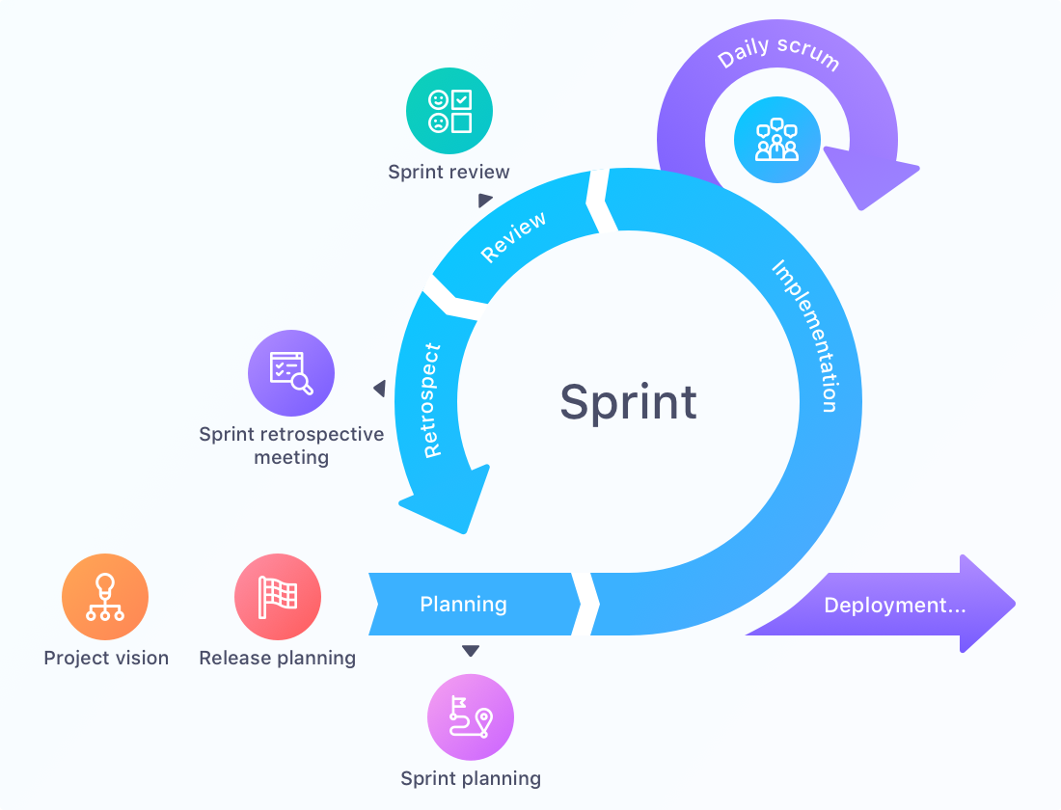
How was the dıvısıon of labor done?
What tasks are our members familiar with?
Speed vs. Learning trade-off
Planning – Designing – Coding loop
How sprints are planned?
Pair programming
Small, frequent chunks of work
Sprint review
Sprint
Sprint retrospective meeting
Project vision
Release planning
Sprint planning

Slide 9
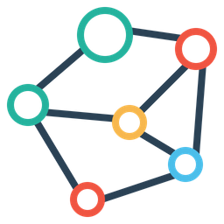
What is planned to be done until the next presentation?
Creating databases for the related data
Transfer designs that is created by Figma to the Android Studio
Make the application do the base functionalities
Connect database to the application impeccably

Slide 10

What are the encountered/possible problems?
Technical problems
Android Studio
Kotlin
Connecting frontend to backend(?)
Installations/Emulators
XML
Managemental problems
Difficulty to arrange a meeting
Busy deadlines for homework and exams
Starting backend too early

Slide 11

How is the architecture in solution?
Bus factor = 3
Pair meeting – General meeting
Spend time on searching the problems’ source
Research & Analysis
Explore & Conceptualization
Think in deep
Design & Vision
Development
Prioritize tasks

Slide 12
MERT GÜRŞİMŞİR
OZAN ÇOLAK
MEHMET METE ŞAMLIOĞLU
MUSTAFA BURAK EMİROĞLU
MUSTAFA MERCAN
ZEKİCAN KAYAOĞLU
PROJECT MANAGER
PRODUCT OWNER
DEVELOPER
DEVELOPER
DEVELOPER
DEVELOPER

